Slide 1

Time Series Analysis of Chicago Crime Data
Robert Erffmeyer

Slide 2
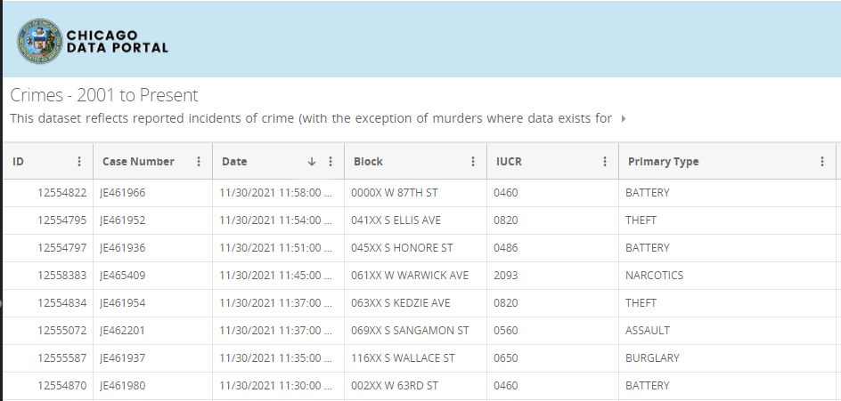
Problem Statement
Chicago Crime Data Available from 2001 to present
Model historical trends, seasonality, cycles using various time series models.
Attempt to forecast test data set of November 2021
From Jan 2001 to Nov 27th 2021, 7,447,985 crime incidents reported.
Dataset at transaction level
Convert to Uniform time series
Hourly imputation unnecessary except for DST
For last 20 years, crimes reported every hour
Transaction Level Data
Hourly Uniform Time Series
Daily Uniform Time Series
https://github.com/Robert-E-630/Time_Series_Final_Project

Slide 3
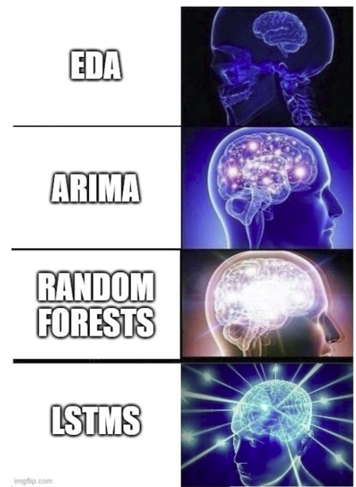
Table of Contents
Assumptions/Hypotheses about data and/or modeling
Data properties (stationarity, correlations, data distribution) and Exploratory data analysis
Data processing (anomaly detection, cleansing and imputations) and transformations
Feature engineering
Proposed approaches (models) with selected model – justification and trade-offs
Results (accuracy) and Future work.

Slide 4
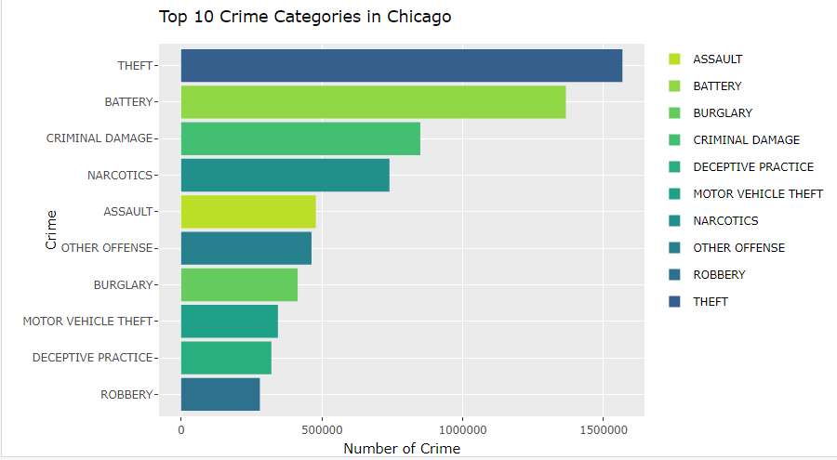
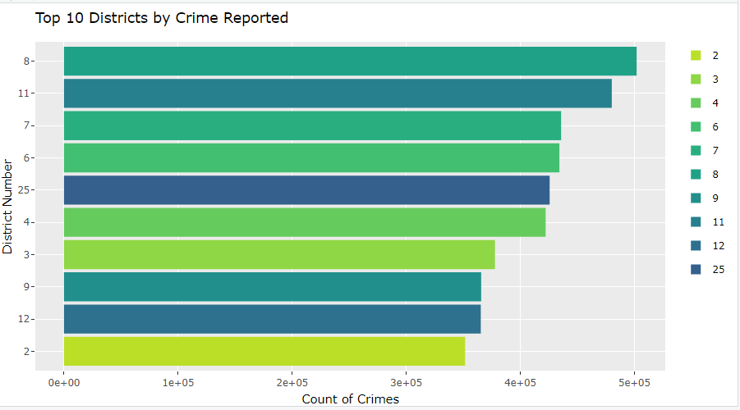
Granularity of Crime Data
Hierarchy to reported crimes
Each reported incident can has a primary type, sub-type and type code.
Geographical hierarchy – areas, districts, wards, blocks
Time stamp of each reported incident
Transaction level – can analyze at Hourly, Daily, Weekly level of aggregations
Aggregate to entire city and add all crime types together

Slide 5
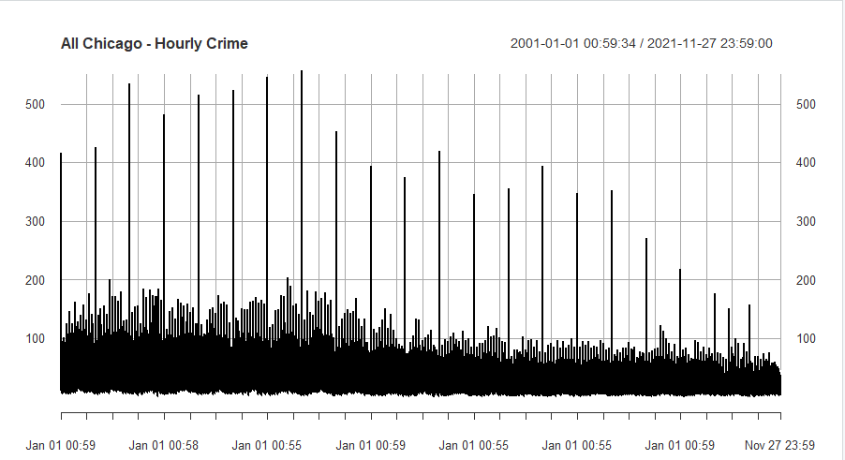
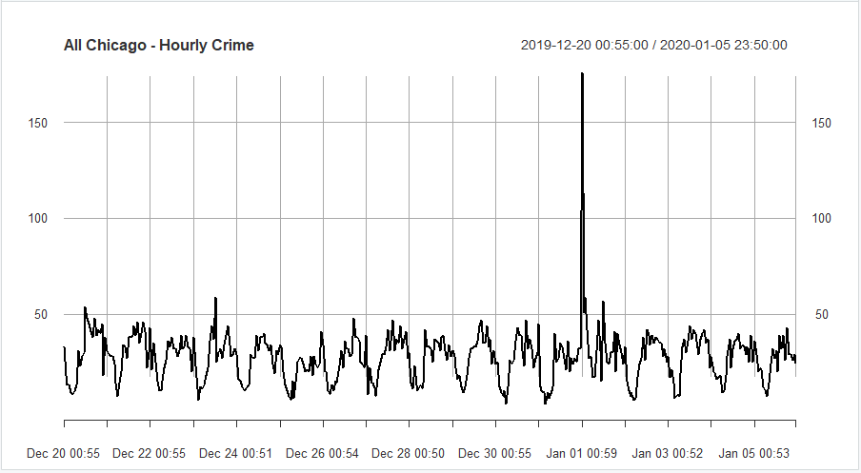
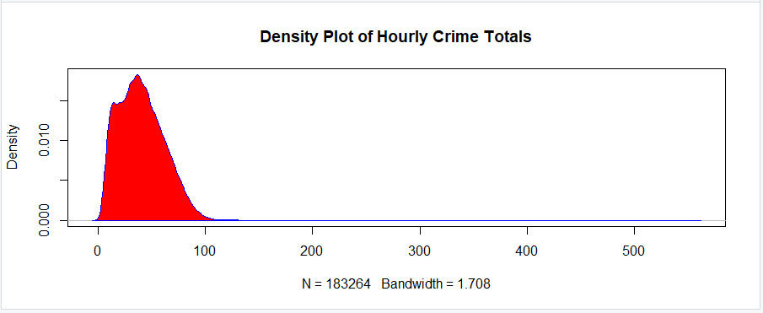
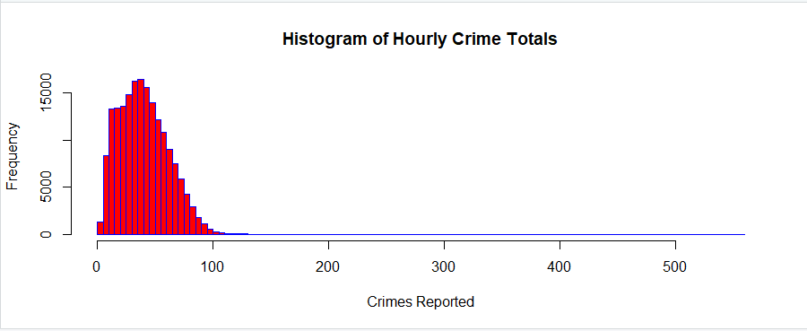
Initial Look at Hourly Time series
Hourly Frequency over 20 years nearly unreadable
However, Significant outliers found during New Years
Heavily left skewed Distribution confirms outliers
24 hour structure appears when zooming in.

Slide 6
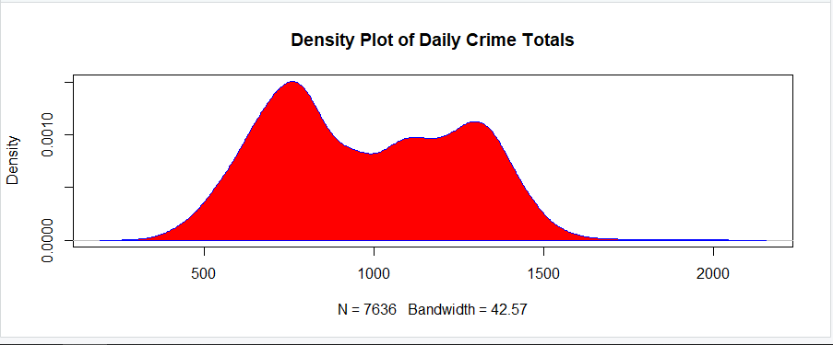
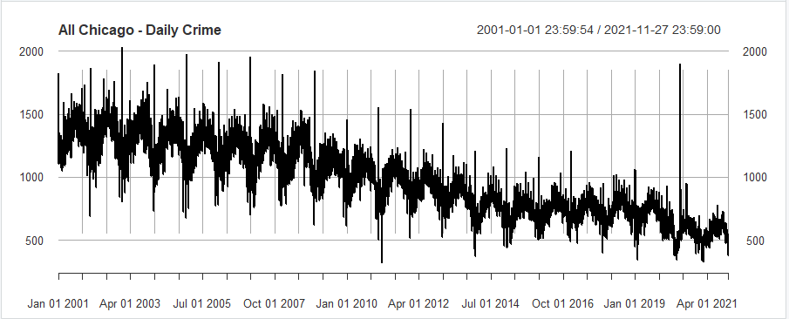
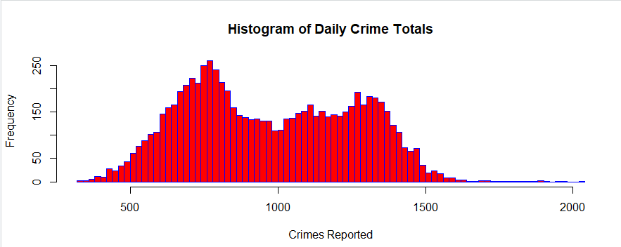
Agg Crime Rate to day Level
Aggregated Crime Rate to Day level shows an overall Decreasing Trend
Still Very Noisy
Outliers present on New Years Day
Heavy right tails
Bivariate Distribution – implying high crime and low crime days

Slide 7
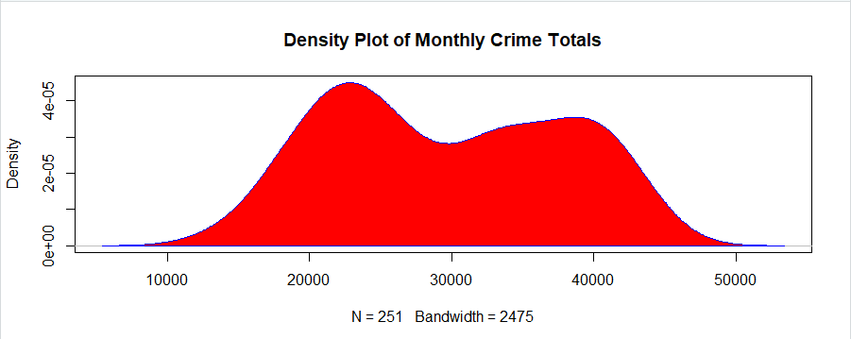
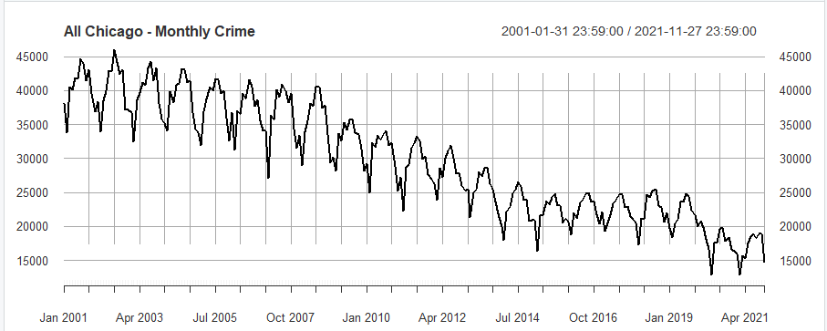
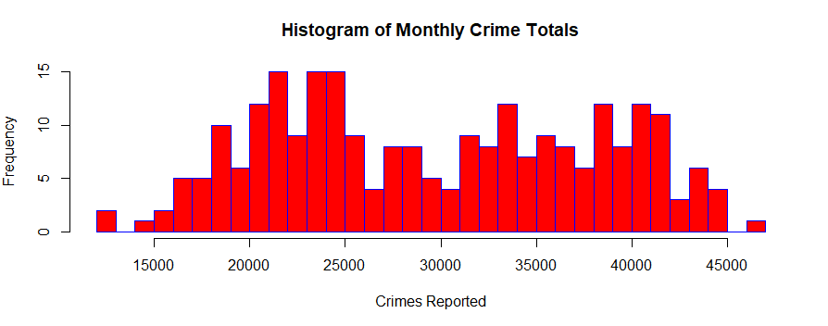
Agg Crime Rate to Month Level
Aggregated Crime Rate to Month level shows an overall Decreasing Trend
Significantly less anomalies
Annual Seasonality appears present.
Bivariate distribution – high and low crime months

Slide 8
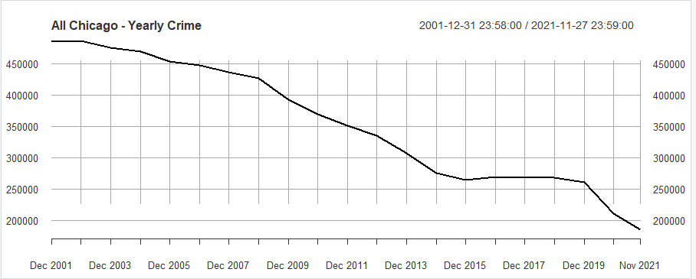
Agg Crime Rate to Year Level
Aggregating to Yearly Level Shows decreasing Trend

Slide 9
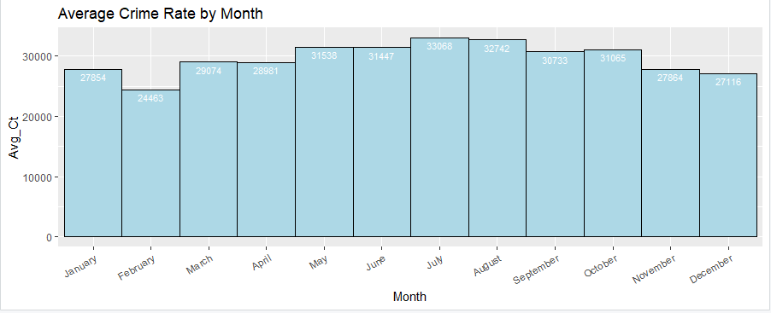
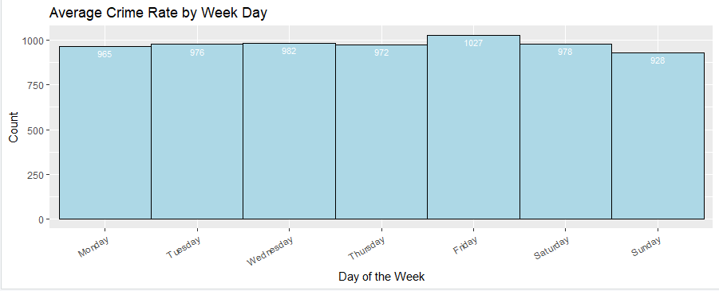
1-EDA for Seasonality
Stark Monthly Seasonality - Higher in June / August / September
Lower in Winter Months.
Up tick in January possibly due to New Years Eve
Some Weekly Seasonality, but not as great as the Monthly
Uptick on Fridays.
Week Day Average does not show signs of Reporting Lags on Mondays

Slide 10
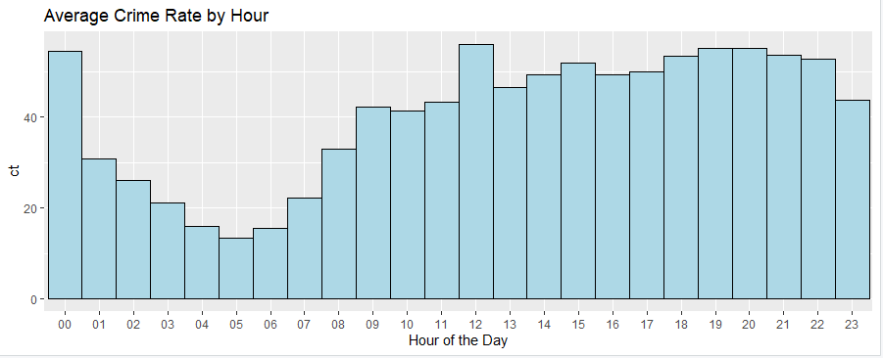
2-EDA for Seasonality
Obvious Hourly Seasonality
Appears theres multiple seasonality – Hourly, Monthly, Weekday, Annual (365)

Slide 11
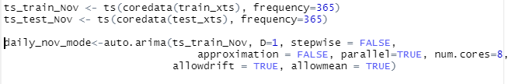
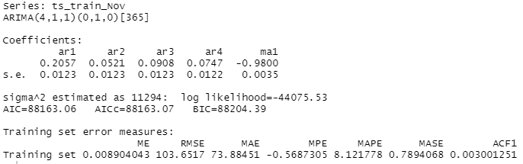
Univariate -SArima Model
Set time series to frequency=365 for annual seasonality
Force Auto Arima to also include Seasonality
Took around 2 hours
Training RMSE - 103

Slide 12
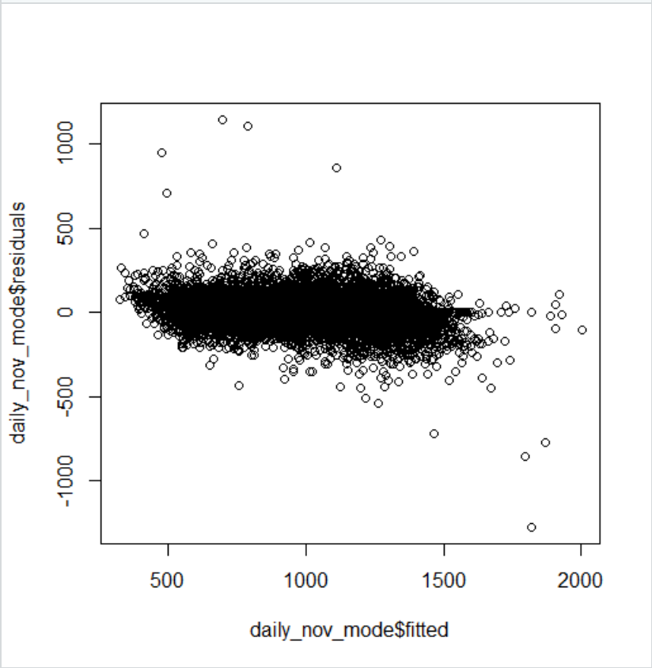
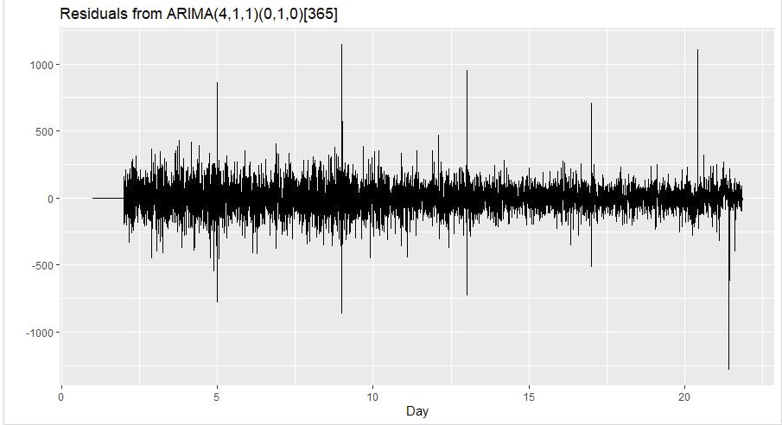
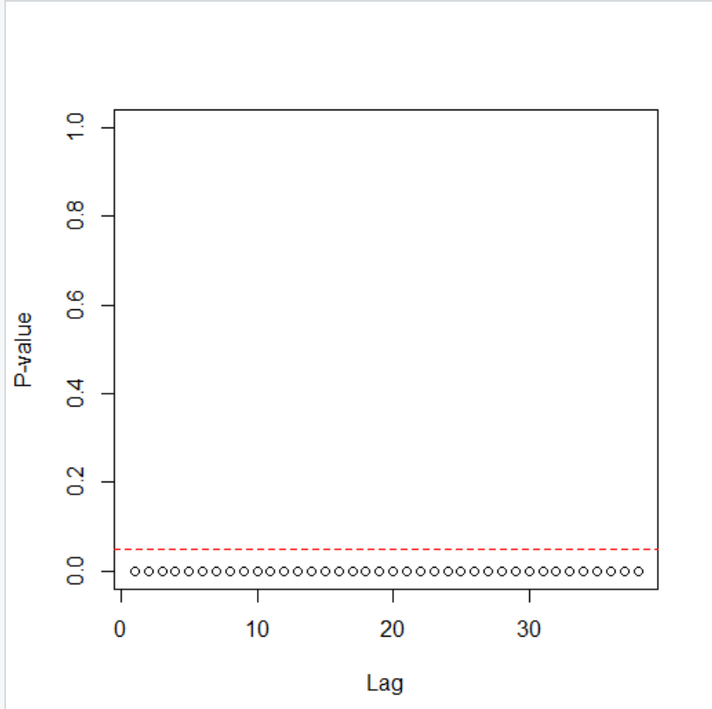
1- SArima -Residual Diagnostics
Residuals appear normal and homoscedastic – lots of outliers
Poor Serial Autocorrelation

Slide 13
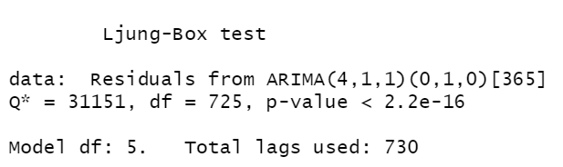
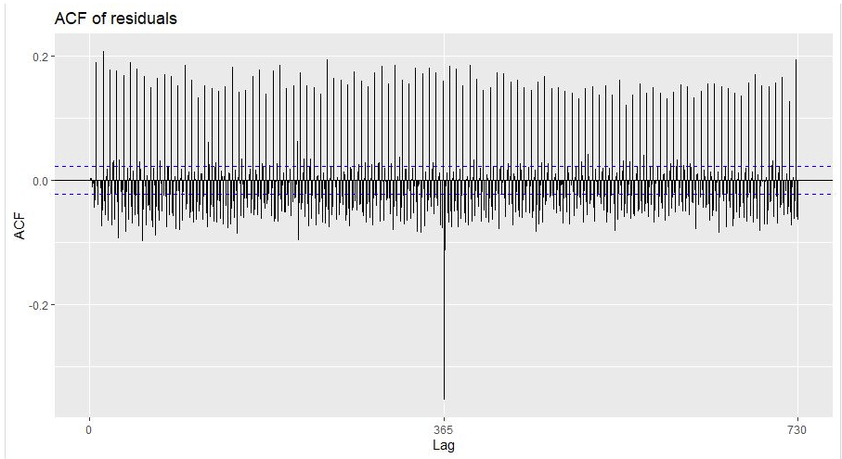
2- SArima -Residual Diagnostics
Residuals appear normal and homoscedastic – lots of outliers
Poor Serial Autocorrelation – Ljung-Box Test – super small p-values, reject null hypothesis of independently distributed residuals

Slide 14
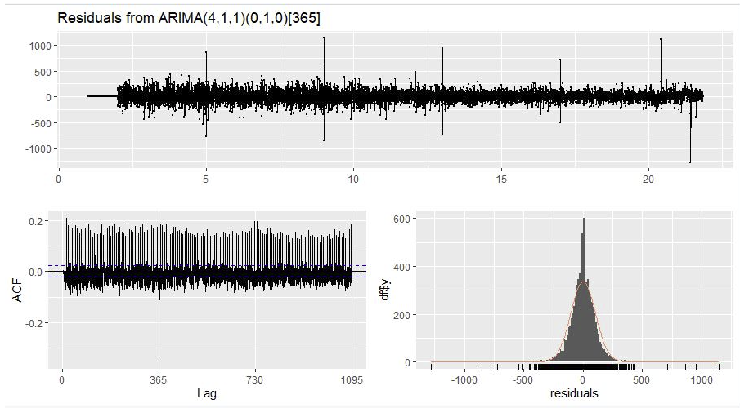
3- SArima -Residual Diagnostics
Residuals appear normal and homoscedastic – lots of outliers
Poor Serial Autocorrelation

Slide 15
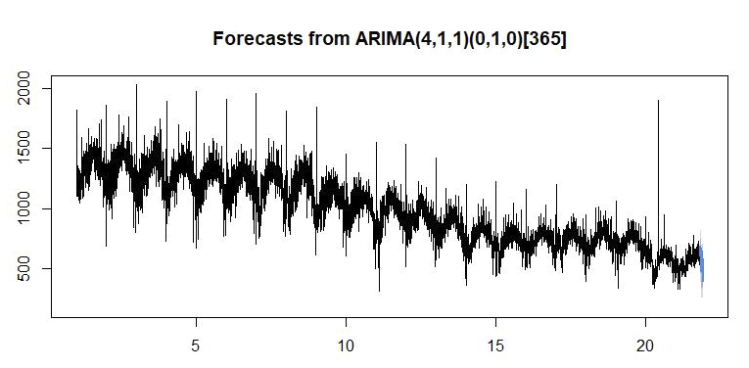
1-SARIMA -Forecasting – Nov 2021 test
Data Assumptions – assume poor residuals will not effect Nov Forecast
Assume training on outliers won’t effect forecast
Forecasted values follow previously seen Time structure

Slide 16
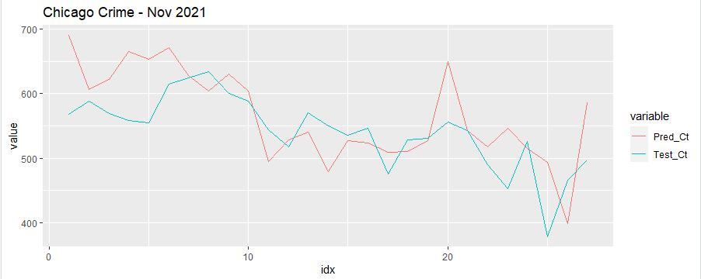
2-SARIMA -Forecasting – Nov 2021 test
Data Assumptions – assume poor residuals will not effect Nov Forecast
Assume training on outliers won’t effect forecast
Forecasted values follow previously seen Time structure
November RMSE - 60

Slide 17
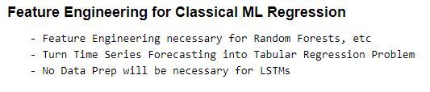
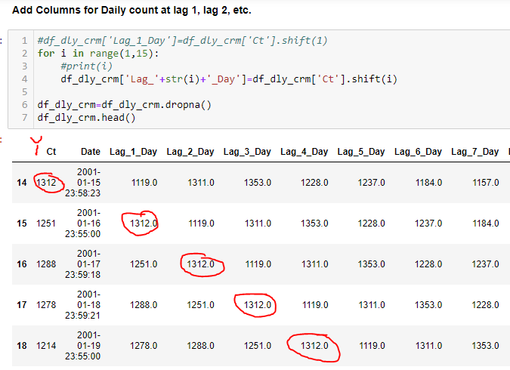
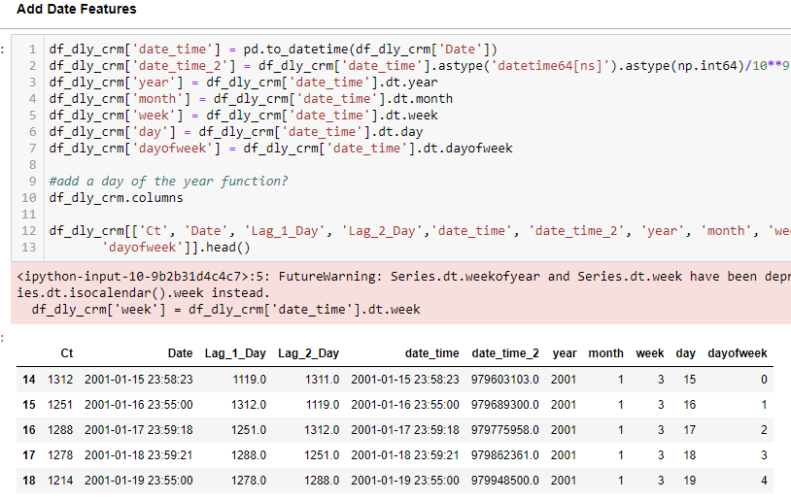
Random Forest – Feature Engineering

Slide 18
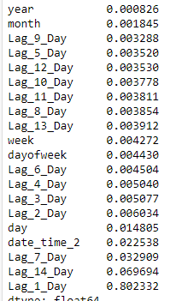
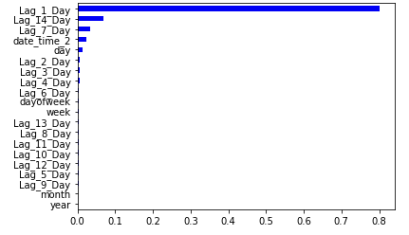
Random Forest –Feature Importance
Very Robust to outliers – relatively easy to tune
Explainability - Gini importance tracks relative contribution (importance) of each feature to the final model

Slide 19
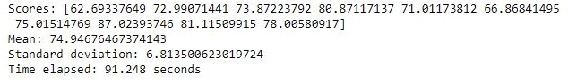
Random Forest –10-fold - Cross Validation

Slide 20
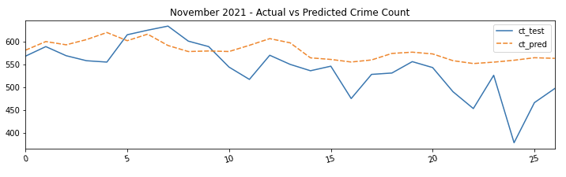
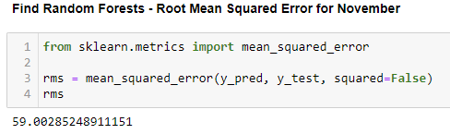
Random Forest -Forecasting – Nov 2021 test
Multi-Step Forecasting slightly difficult - Because engineered features based on date
When Forecasting future steps, 1st have to add new date, then add re-engineer features for that new date.
Test Accuracy as measured by RMSE – 59 same as SARIMA.

Slide 21
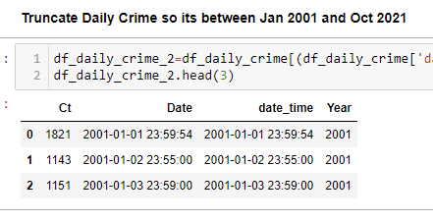
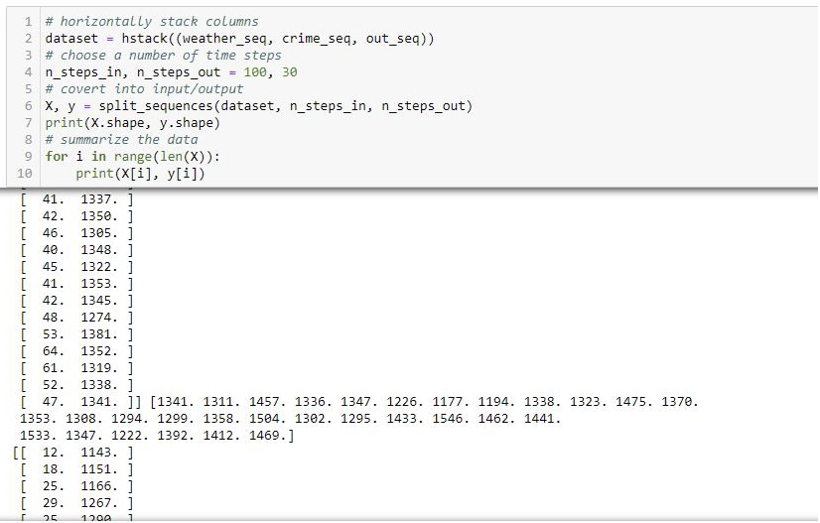
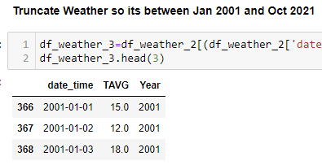
Lstm – data prep
Multiple Input and Multi-Step Output.
Prior Sequence Length of 100 time steps, 2 Features because two input time series
X’s are matrices 100x2
Output are matrices 30 x1 – Forecasting 30 day future window

Slide 22
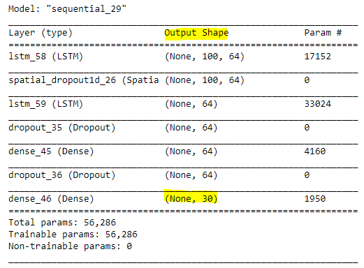
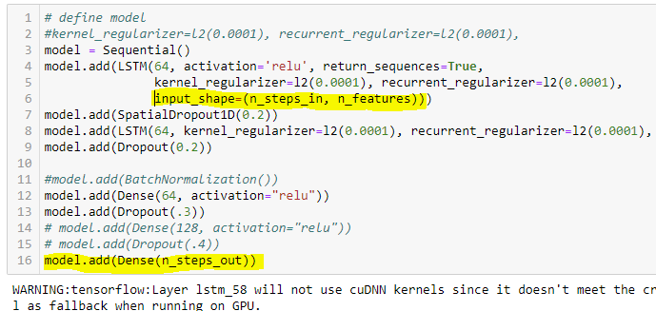
LSTM-architecture
Input and Output Shapes important

Slide 23
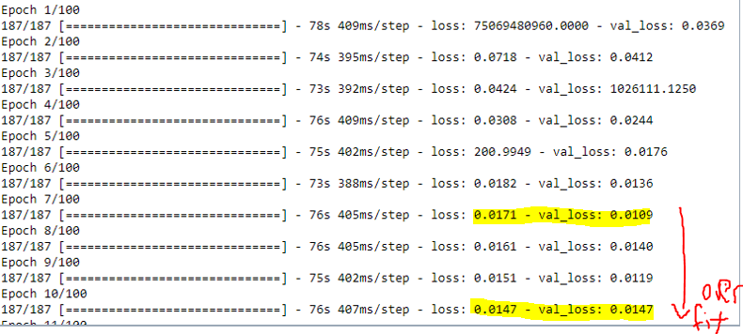
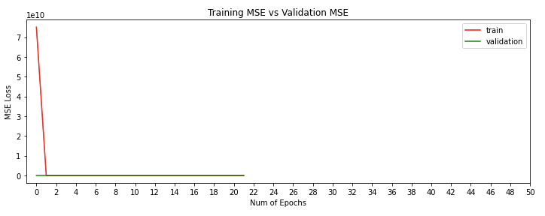
Lstm - Training
Training very difficult – watch out for exploding gradients and over fitting

Slide 24
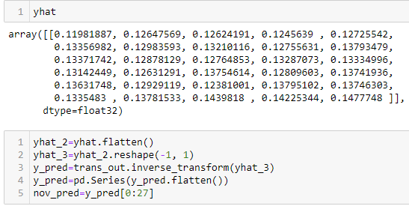
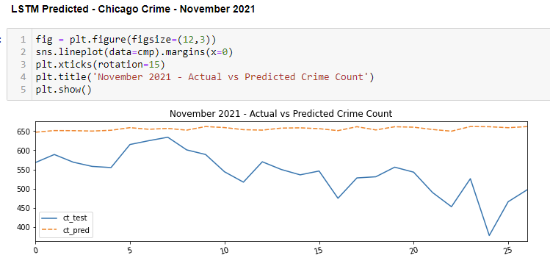
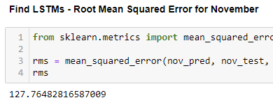
LSTM-Forecasting – Nov 2021 test
Want last X matrix as input for Forecast
Architecture of NN automatically forecastes 30 day windows
No Need for forecasting future temperatures
127 RMSE – not super impressive – hard to tune

